Slide 1
SURF2022 Group B Progress Report 2

Slide 2
Content
UWMGI work descriptions
UWMGI work difficulties
Discussion

Slide 3
Works on 2D dataset
Firstly we used classic networks to deal with the data as 2D type(H&W)
The baseline code to train models and submit results is provided by Awsaf, the model and backbone network he used is Unet and efficientnet-b1, supported by segmentation_models_pytorch library.
Train: https://www.kaggle.com/code/awsaf49/uwmgi-unet-train-pytorch
Infer: https://www.kaggle.com/code/awsaf49/uwmgi-unet-infer-pytorch

Slide 4
Results in different networks
The main operation we used is changing the networks in the model part of baseline code. The backbone network is kept effientnet-b1 with the pretrained model (using Imagenet for pretraining) supported by segmentation model pytorch lib. The CFG parameters and other parameters are changed slightly.
By using Unet, we got a public score 0.838 in 20 epochs
By using Unet++, we got a public score 0.846 in 20 epochs

Slide 5
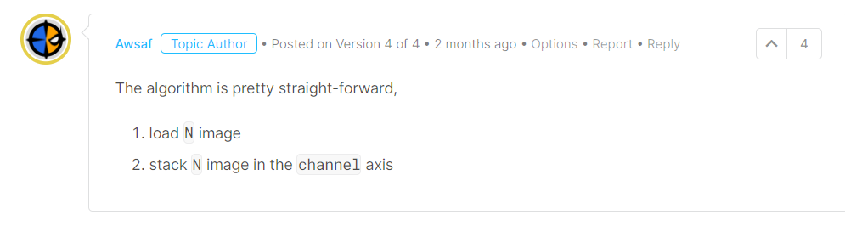
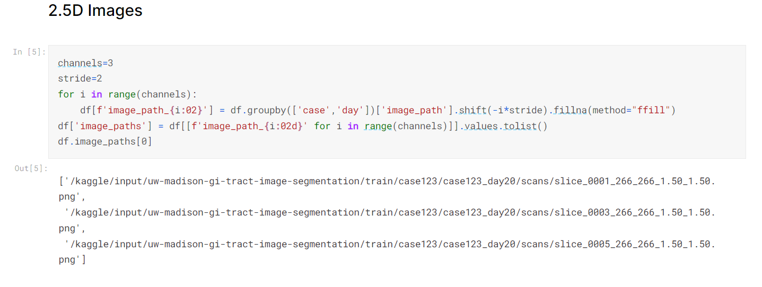
2.5D dataset
After trying many models, we considered that more trials in 2D data can improve performance slightly.
Inspired by Aswaf again, we tried some models by the same way.
The mask dataset and preprocess data code are all provided by Aswaf, the main idea to achieve transforming 2D data into 2.5Ddata is shown below.

Slide 6
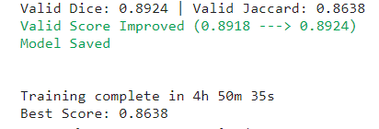
Results in different networks
1. By using Unet, we got a score 0.860 in 5 epochs
2. By using DeeplabV3, we got a score 0.715 in 1 epoch
And a score 0.764 in 5 epochs
One epoch used 7 hours for training, 2 hours for marking in Kaggle, it is really a costly model.
3. We also used UnetPlusPlus with backbone regnety_008,016,032, but the pretrain model parameters are not provided by segmentation model pytorch lib, so we have not used it in infer. to get a score.
Regnet_008 in 5 epochs:
Valid Jaccard: 0.8717 Valid Dice: 0.9007
Regnety_032 in 5 epochs

Slide 7
3D dataset
Inspired by yiheng wang, we can also produce 3D data and use the processed data as input to train model. The baseline code of pipeline training, 3d data preprocess, and infer are supported by MONAI frame.
As the short time, we did not run the train file successfully, but we tried the 2d23d preprocess code and the infer. by using the model trained by Yash Goel. It can achieve a score 0.871.

Slide 8
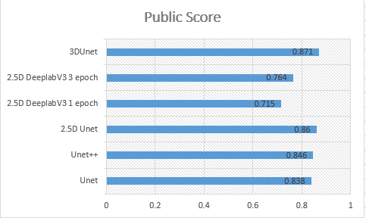
Results in UWMGI competition

Slide 9
UWMGI work difficulties
Learn the frames, libraries and code skills from the better participants. During the process we tried and learnt from others.
We have two problems:
1. we cannot reproduce the pipeline train file shared by yiheng.
2. we cannot get the pretrain model and model parameters except efficientnet from segmentation model pytorch library without Internet.
If you can do that, contact us or share it in the meeting. Thank you.

Slide 10
Plans till the UWMGI competition end
We have some plans about the days to the competition ending:
1. Try to reproduce the 3D MONAI Unet Solution.
2. Try to solve the problem of 2.5D inference without Internet connection in Kaggle.
3. Learn the experience of constructing a model by using more advanced APIs and preprocessing the medical data.
4. Try to start another one competition.

Slide 11
Q&A & Thank you for listening

